Slide 1
Ch. 1 – Overview of Wireless LANs (WLANs)
Fundamentals of Wireless LANs
Spring 2008
PowerPoints created by Rick Graziani of Cabrillo College

Slide 2


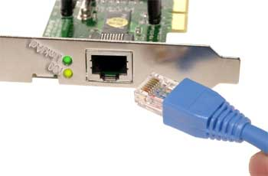
What is a wireless LAN?
Wireless LAN (WLAN) - provides all the features and benefits of traditional LAN technologies such as Ethernet, but without the limitations of wires or cables.
Rick Graziani graziani@cabrillo.edu

Slide 3
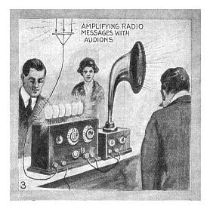
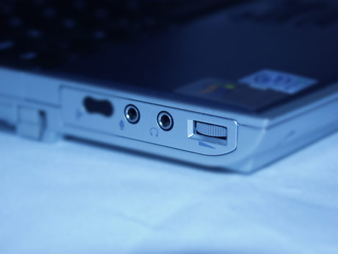
What is a wireless LAN?
http://earlyradiohistory.us/1920au.htm
WLAN, like a LAN, requires a physical medium to transmit signals.
Instead of using UTP, WLANs use:
  Infrared light (IR)
    802.11 does include an IR specification
    limitations, easily blocked, no real 802.11 products (IrDA)
  Radio frequencies (RFs)
    Can penetrate most office obstructions
Rick Graziani graziani@cabrillo.edu

Slide 4
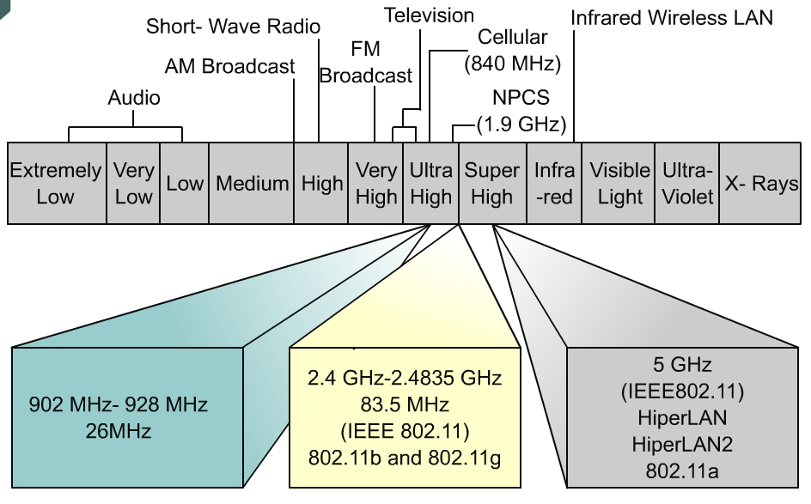
What is a wireless LAN?
More later!
WLANs use the 2.4 GHz and 5-GHz frequency bands.
ISM (Industry, Scientific, Medical) license-free (unlicensed) frequency bands.
S-Band ISM
  802.11b and 802.11g: 2.4- 2.5 GHz
C-Band ISM
  802.11a: 5.725 – 5.875 GHz
Rick Graziani graziani@cabrillo.edu

Slide 5
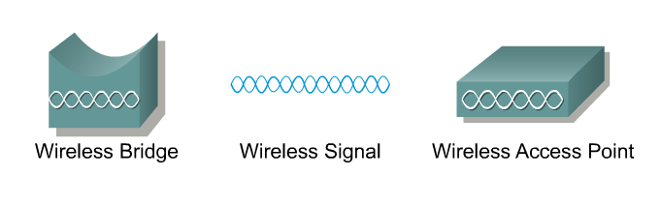
Icons – Wireless Devices and Functions
Rick Graziani graziani@cabrillo.edu

Slide 6
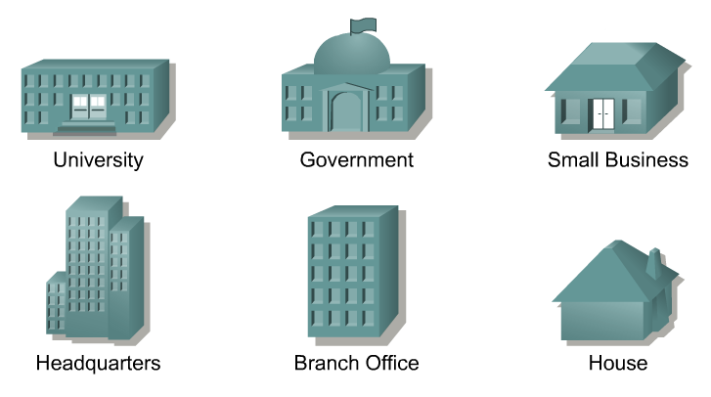
Icons - Buildings
Rick Graziani graziani@cabrillo.edu

Slide 7
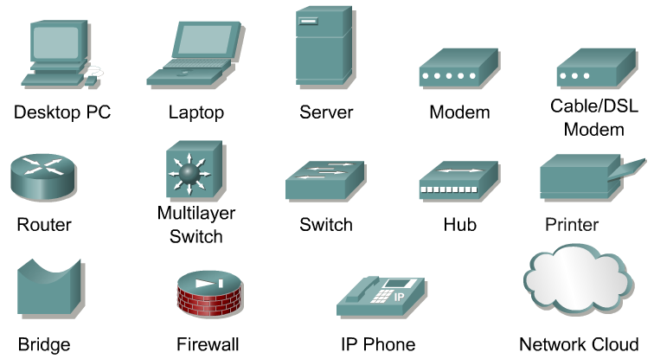
Icons – Typical Wired Network Devices
Rick Graziani graziani@cabrillo.edu

Slide 8
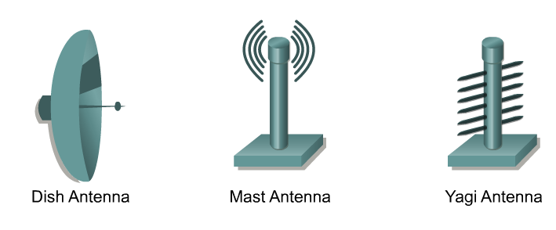
Icons – Wireless LAN Antenna
Rick Graziani graziani@cabrillo.edu

Slide 9
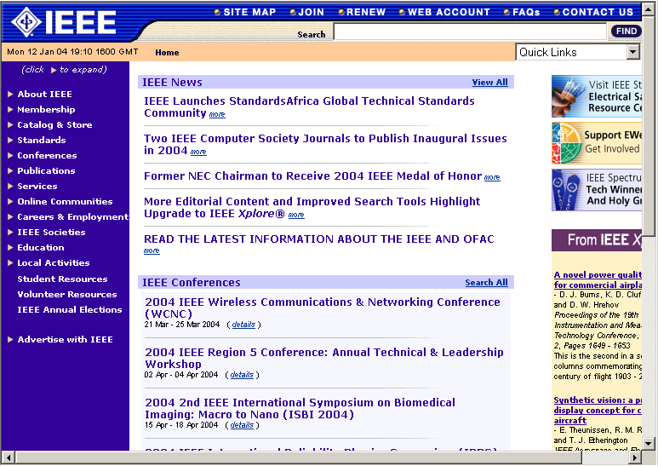
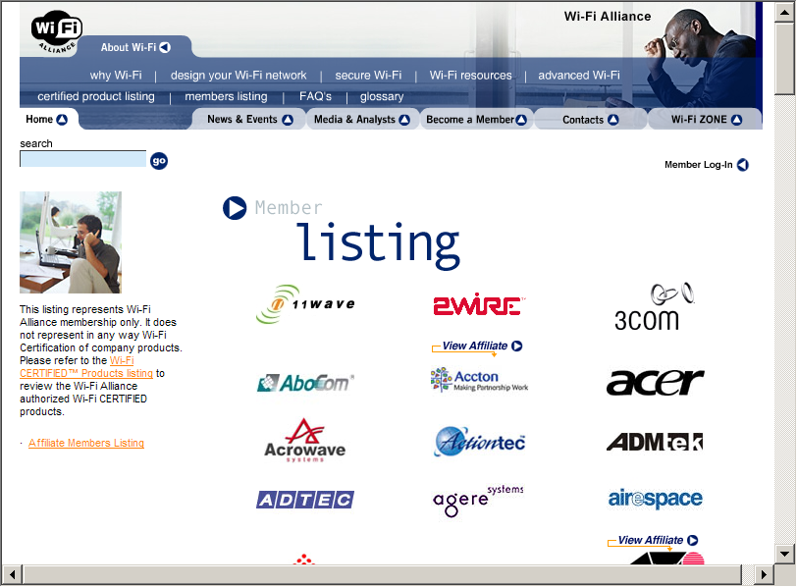
IEEE 802.11 and the Wi-Fi Alliance
IEEE LAN/MAN Standards Committee (LMSC)
  First 802.11 standard released in 1997, several since then
Wireless Ethernet Compatibility Alliance (WECA)
  Advertises its Wi-Fi (wireless fidelity) program
  Any 802.11 vendor can have its products tested for interoperability
  Cisco is a founding member
Rick Graziani graziani@cabrillo.edu

Slide 10

Wi-Fi™
Wi-Fi™ Alliance
  WECA changed its name to Wi-Fi
  Wireless Fidelity Alliance
  170+ members
  Over 350 products certified
Wi-Fi’s™ Mission
  Certify interoperability of WLAN products (802.11)
  Wi-Fi™ is the “stamp of approval”
  Promote Wi-Fi™ as the global standard
Rick Graziani graziani@cabrillo.edu

Slide 11
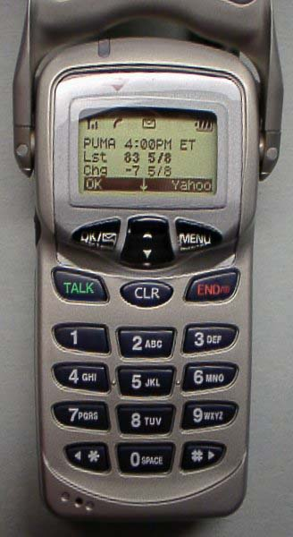
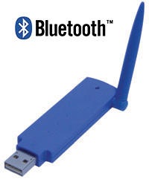
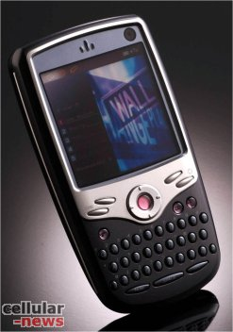

Other Wireless Technologies
Not discussed in this course:
Cellular
Bluetooth or PAN (Personal Area Network)
3G (3rd Generation)
UWB (Ultra Wide Band)
FSO (Free Space Optics)
Radio waves off meteor trails!
Rick Graziani graziani@cabrillo.edu

Slide 12
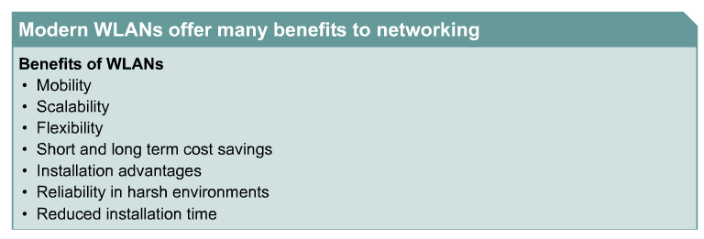
Why Wireless?
Rick Graziani graziani@cabrillo.edu

Slide 13

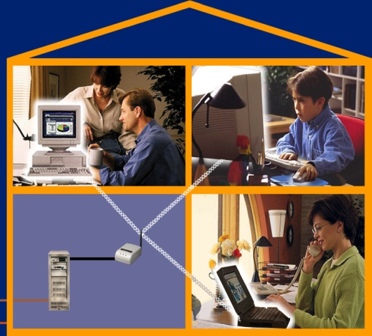
WLAN Evolution
Warehousing
Retail
Healthcare
Education
Businesses
Home
860 Kbps
1 and 2 Mbps
54 Mbps
Speed
1 and 2 Mbps
11 Mbps
Network
Proprietary
Standards-based
Radio
900 MHz
2.4 GHz
2.4 GHz
5 GHz
IEEE 802.11Begins Drafting
802.11
Ratified
802.11a,b
Ratified
802.11g
Drafted
1986
1988
1990
1992
1994
1996
1998
2000
2002
Rick Graziani graziani@cabrillo.edu

Slide 14
Current Standards – a, b, g
860 Kbps
1 and 2 Mbps
54 Mbps
Speed
1 and 2 Mbps
11 Mbps
Network
Proprietary
Standards-based
Radio
900 MHz
2.4 GHz
2.4 GHz
5 GHz
IEEE 802.11Begins Drafting
802.11
Ratified
802.11a,b
Ratified
802.11g
Ratified
1986
1988
1990
1992
1994
1996
1998
2000
2003
802.11a
  Up to 54 Mbps
  5 GHz
  Not compatible with either 802.11b or 802.11g
802.11b
  Up to 11 Mbps
  2.4 GHz
802.11g
  Up to 54 Mbps
  2.4 GHz
More later!
802.11g is backwards compatible with 802.11b, but with a drawback (later)
Rick Graziani graziani@cabrillo.edu

Slide 15
802.11 PHY (Physical Layer) Technologies
860 Kbps
1 and 2 Mbps
54 Mbps
Speed
1 and 2 Mbps
11 Mbps
Network
Proprietary
Standards-based
Radio
900 MHz
2.4 GHz
2.4 GHz
5 GHz
IEEE 802.11Begins Drafting
802.11
Ratified
802.11a,b
Ratified
802.11g
Ratified
1986
1988
1990
1992
1994
1996
1998
2000
2003
More later!
Infrared light
Three types of radio transmission within the unlicensed 2.4-GHz frequency bands:
  Frequency hopping spread spectrum (FHSS) 802.11b (not used)
  Direct sequence spread spectrum (DSSS) 802.11b
  Orthogonal frequency-division multiplexing (OFDM) 802.11g
One type of radio transmission within the unlicensed 5-GHz frequency bands:
  Orthogonal frequency-division multiplexing (OFDM) 802.11a
Rick Graziani graziani@cabrillo.edu

Slide 16
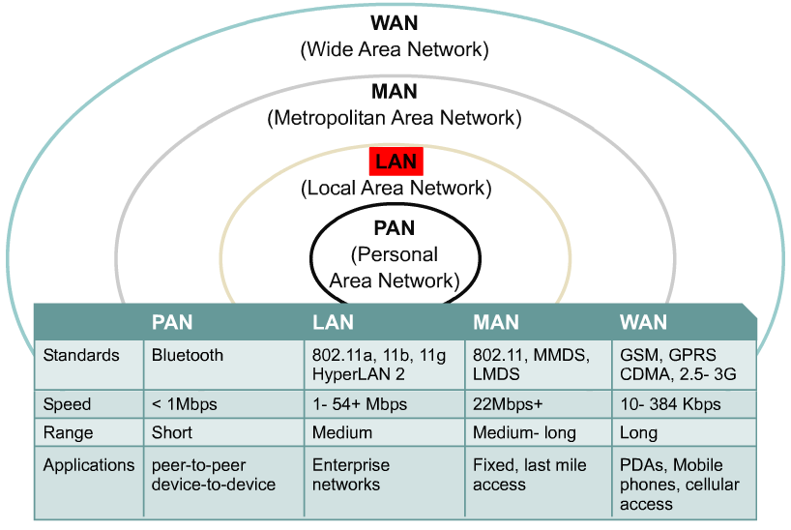
Atmosphere: the wireless medium
Wireless signals are electromagnetic waves
No physical medium is necessary
The ability of radio waves to pass through walls and cover great distances makes wireless a versatile way to build a network.
Rick Graziani graziani@cabrillo.edu

Slide 17
Components Review

Slide 18
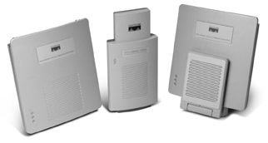
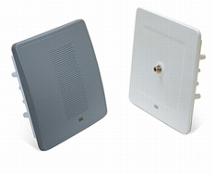
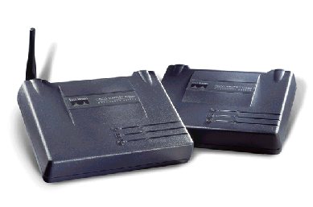
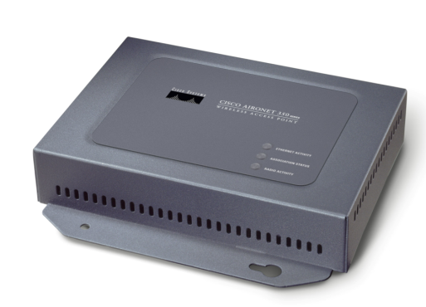
WLAN Devices
In-building Infrastructure
  1200 Series (802.11a and 802.11b)
  1100 Series (802.11b)
  350 Series (802.11b) not shown
Bridging
  350 Series (802.11b)
    BR350
    WGB350
  1300 Series (802.11a)
1300
1100
1200
340/350
1200
Rick Graziani graziani@cabrillo.edu

Slide 19
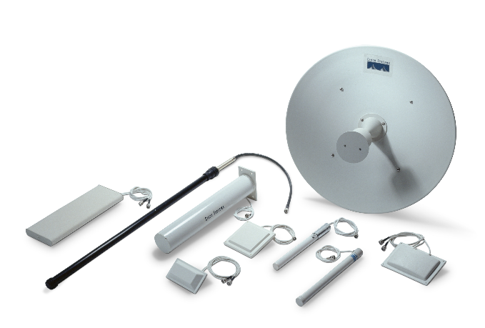
Antennas
Antenna
  2.4GHz Antennas
  5 GHz Antennas
Rick Graziani graziani@cabrillo.edu

Slide 20
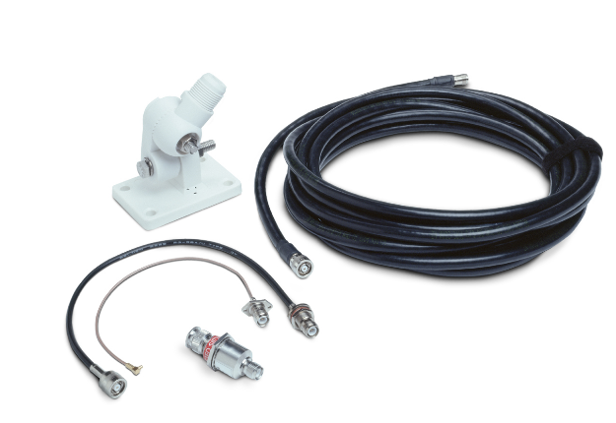
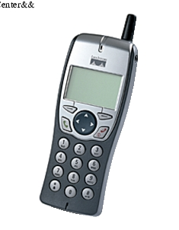
Cable, Accessories, Wireless IP Phone
Cable and Accessories
  Low Loss Cable
  Antenna Mounts
  Lightening Arrestor
  Wireless IP Phone
Rick Graziani graziani@cabrillo.edu

Slide 21
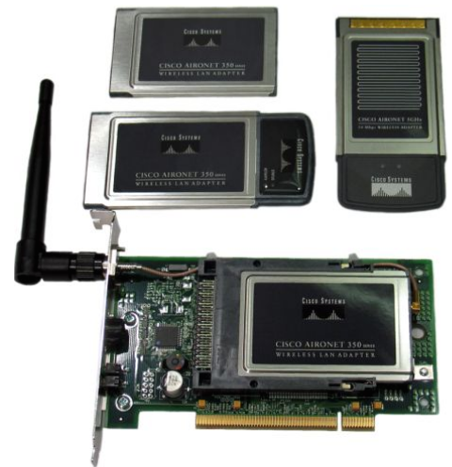
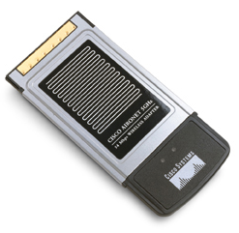
Client Adapters
Clients (NICs)
  350 Series (802.11b)
  5 GHz client adapter (802.11a)
Drivers are supported for all popular operating systems, including Windows 95, 98, NT 4.0, Windows 2000, Windows ME, Windows XP, Mac OS Version 9.x, and Linux.
Rick Graziani graziani@cabrillo.edu

Slide 22
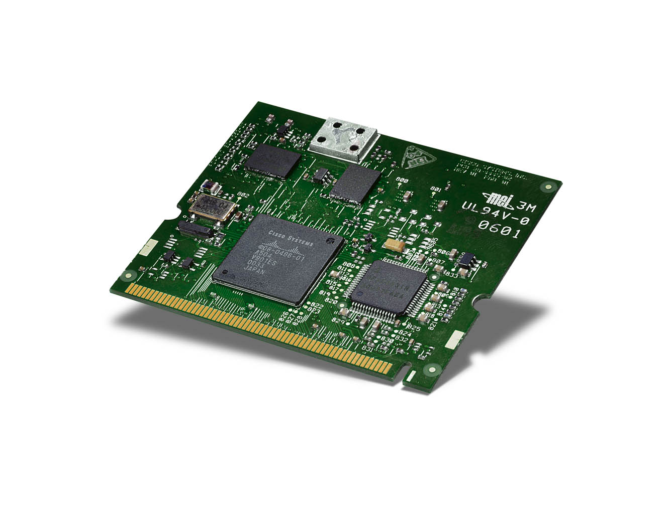
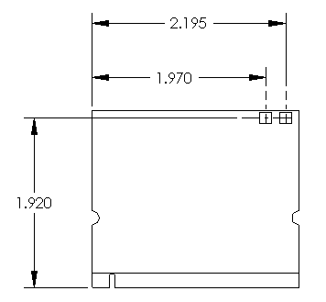
Cisco Aironet 350 Series Mini PCI Adapter
2.4 GHz/802.11b embedded wireless for notebooks
100 mW transmit power
Must order through PC manufactures (not orderable directly through Cisco)
Rick Graziani graziani@cabrillo.edu

Slide 23
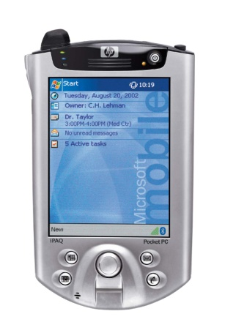
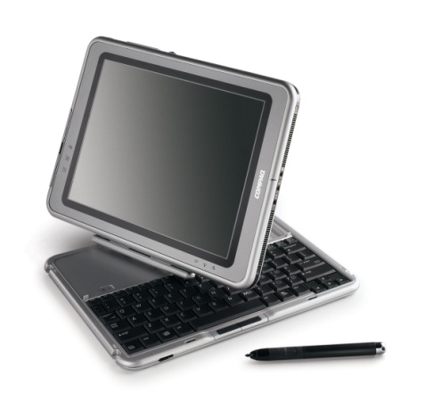
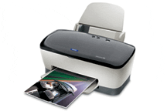
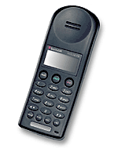
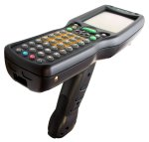
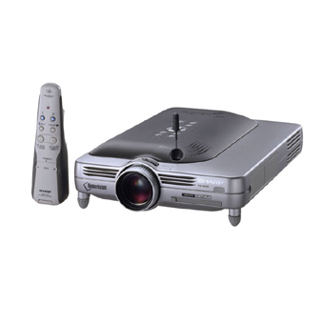
Beyond Laptops:
Other 802.11-Enabled Devices
HP iPAQ 5450 PDA
Epson Printer
PDA’s
Phones
Printers
Projectors
Tablet PC’s
Security Cameras
Barcode scanners
Custom devices for vertical markets:
  Healthcare
  Manufacturing
  Retail
  Restaurants
Compaq Tablet PC
SpectraLink Phone
HHP Barcode Scanner
Sharp M25X Projector
Rick Graziani graziani@cabrillo.edu

Slide 24

“Business-Class”vs Consumer WLAN
Industry has segmented: consumer vs. business
“Cisco” offers only “business-class” products:
  Security
  Upgradeability
  Network management
  Advanced features
  Choice of antennas
  Highest throughput
  Scalability
Rick Graziani graziani@cabrillo.edu

Slide 25
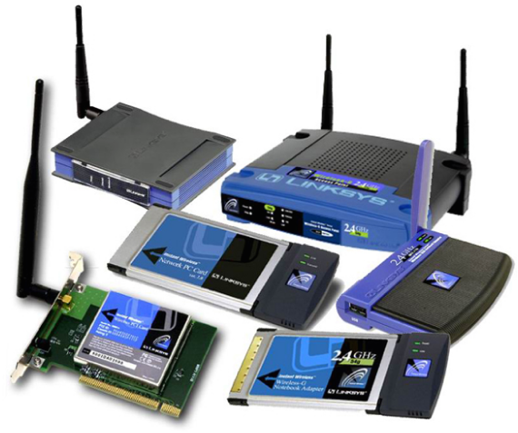
Consumer wireless products
There is a real difference in functionality and administrative capabilities between Business-class and Consumer wireless products.
Rick Graziani graziani@cabrillo.edu

Slide 26
Wireless LAN Market

Slide 27
Momentum is Building in Wireless LANs
Wireless LANs are an “addictive” technology
Strong commitment to Wireless LANs by technology heavy-weights
  Cisco, IBM, Intel, Microsoft
Embedded market is growing
  Laptop PC’s with “wireless inside”
  PDA’s
The WLAN market is expanding from Industry-Specific Applications, to Universities, Homes, & Offices
Professional installers and technicians will be in demand
Rick Graziani graziani@cabrillo.edu

Slide 28
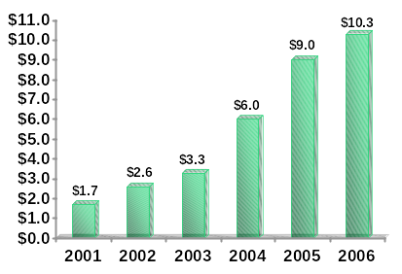
Wireless LANs Are Taking Off
Worldwide WLAN Market
*includes embedded clients, add-on client cards, & infrastructure equipment for both the business and consumer segments
Growth Due To:
Standards
High Bandwidth Needs
Low Cost
Embedded in Laptops
Variety of Devices
Voice + Data
Multiple Applications
Security Issues Solved
Ease of Deployment
Network Mgmt. Tools
Enterprise Adoption
($ Billions)
CAGR = 43%
Source: Forward Concepts, 2003
Rick Graziani graziani@cabrillo.edu

Slide 29
Four main requirements for a WLAN solution
High availability — High availability is achieved through system redundancy and proper coverage-area design.
Scalability — Scalability is accomplished by supporting multiple APs per coverage area, which use multiple frequencies. APs can also perform load balancing, if desired.
Manageability — Diagnostic tools represent a large portion of management within WLANs. Customers should be able to manage WLAN devices through industry standard APIs, including SNMP and Web, or through major enterprise management applications like CiscoWorks 2000, Cisco Wireless Control System or AirMagnet
Open architecture — Openness is achieved through adherence to standards such as 802.11a and 802.11b, participation in interoperability associations such as the Wi-Fi Alliance, and certification such as U.S. FCC certification.
Rick Graziani graziani@cabrillo.edu

Slide 30
Other requirements
Security — It is essential to encrypt data packets transmitted through the air. For larger installations, centralized user authentication and centralized management of encryption keys are also required.
Cost — Customers expect continued reductions in price of 15 to 30 percent each year, and increases in performance and security. Customers are concerned not only with purchase price but also with total cost of ownership (TCO), including costs for installation.
Rick Graziani graziani@cabrillo.edu

Slide 31
Challenges and Issues

Slide 32
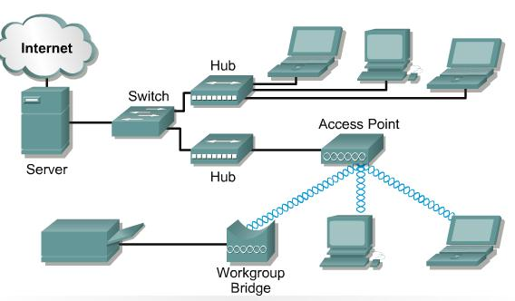
Radio Signal Interference
Network managers must ensure that different channels are utilized.
Because the 802.11 standards use unlicensed spectrum, changing channels is the best way to avoid interference.
If someone installs a link that interferes with a wireless link, the interference is probably mutual.
Rick Graziani graziani@cabrillo.edu

Slide 33
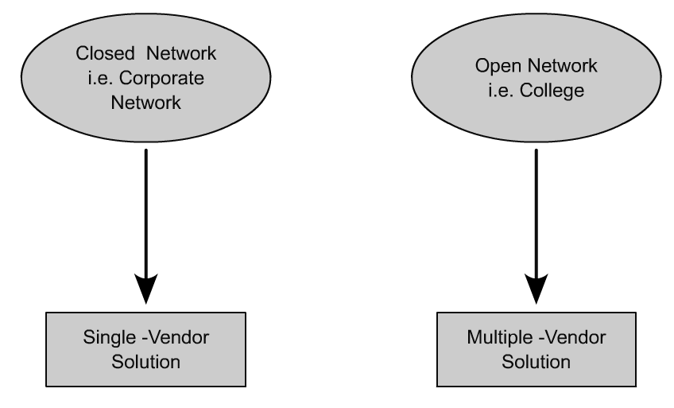
Interoperability
Non-standard (for now) 802.11 devices include:
  Repeater APs
  Universal Clients (Workgroup Bridges)
  Wireless Bridges
Cisco bridges, like many other vendor bridges, are proprietary implementations of the 802.11 standard and therefore vendor interoperability cannot be attained.
Rick Graziani graziani@cabrillo.edu

Slide 34
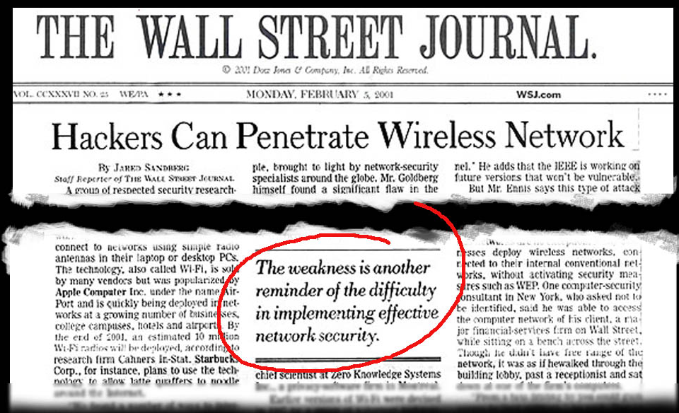
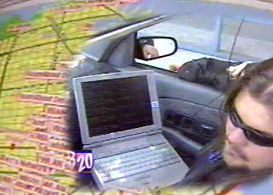
Wireless LAN Security: Lessons
“War Driving”
Hacking into WEP
Lessons:
Security must be turned on (part of the installation process)
Employees will install WLAN equipment on their own (compromises security of your entire network)
WEP keys can be easily broken (businesses need better security)
Rick Graziani graziani@cabrillo.edu

Slide 35
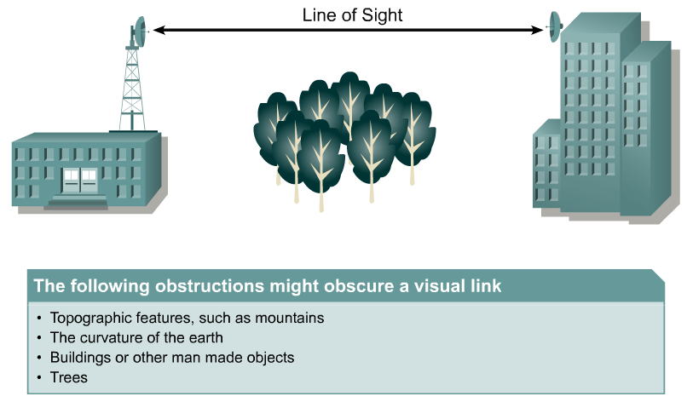
Installation and Site Design Issues—Bridging
Rick Graziani graziani@cabrillo.edu

Slide 36
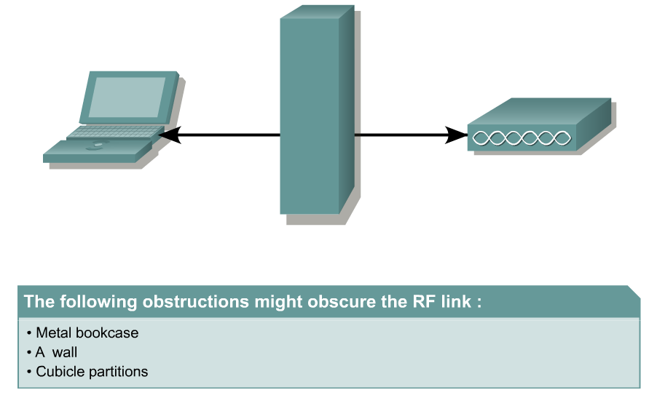
Installation and Site Design Issues—WLAN
Rick Graziani graziani@cabrillo.edu

Slide 37
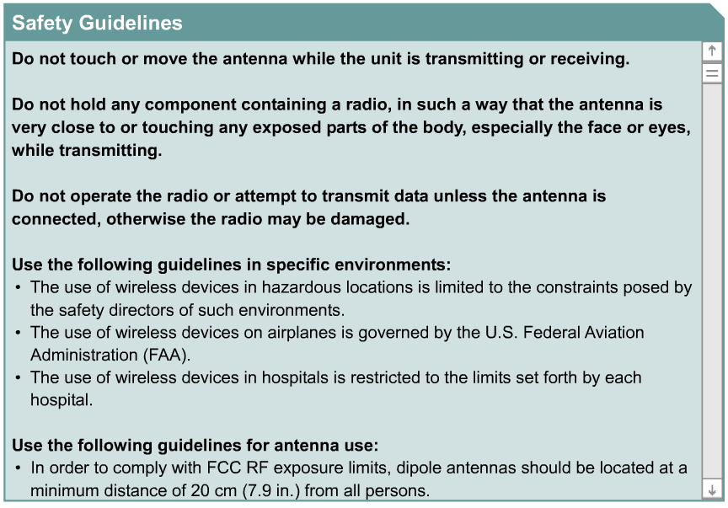
Health Issues
Rick Graziani graziani@cabrillo.edu

Slide 38
IEEE 802.11 Standards Activities
802.11a: 5GHz, 54Mbps
802.11b: 2.4GHz, 11Mbps
802.11d: Multiple regulatory domains
802.11e: Quality of Service (QoS)
802.11f: Inter-Access Point Protocol (IAPP)
802.11g: 2.4GHz, 54Mbps
802.11h: Dynamic Frequency Selection (DFS) and Transmit Power Control (TPC)
802.11i: Robust Security Network
802.11j: Japan 5GHz Channels (4.9-5.1 GHz)
802.11k: Measurement
802.11n: High throughput standard > 100Mbps
Project. working group task group
802.11n
Rick Graziani graziani@cabrillo.edu

